Slide 1
Iles de Paix Luxembourg Lions Club Luxembourg Cercle Munster, 23 November 2022 Stéphane Ries, President Florence Lagravere, Fundraising Manager
Together,
let’s cultivate the
dignity of everyone.

Slide 2
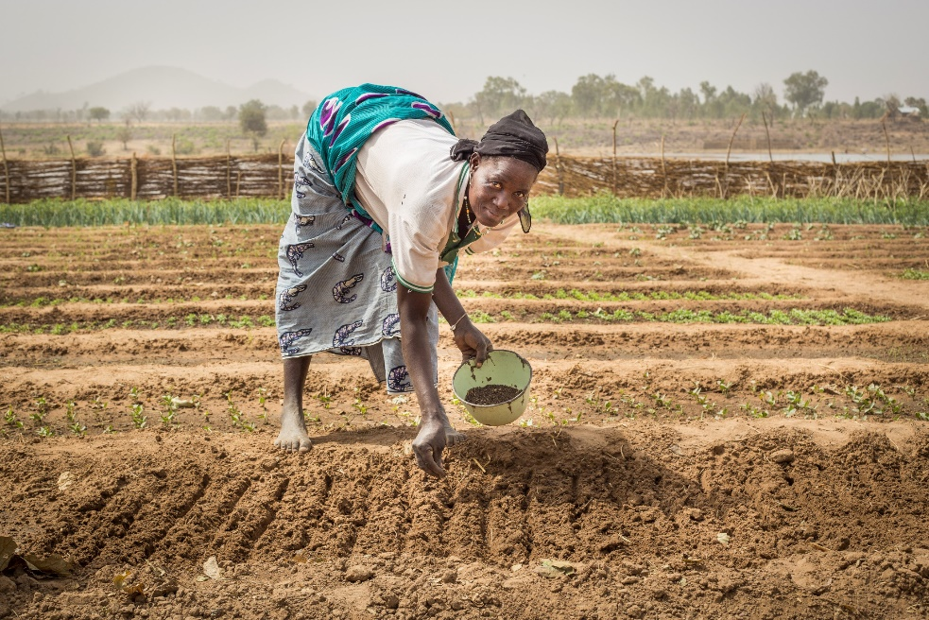
Who are we?
Iles de Paix (Islands of Peace) is an NGO founded in Belgium more than 50 years ago by Dominique Pire, winner of the 1958 Nobel Peace Prize. Our Luxembourg branch has been active since 1955, is accredited by the Ministry of Foreign and European Affairs (MAEE) and a member of the “Cercle des ONG” since 1995.
We receive the support of the ministry for the implementation of our programs in Africa and Latin America, as well as in Luxembourg for our Education for Sustainable Development program.
Our mission is to train and support disadvantaged rural populations in order to improve food security and quality of life in a sustainable and autonomous way.

Slide 3
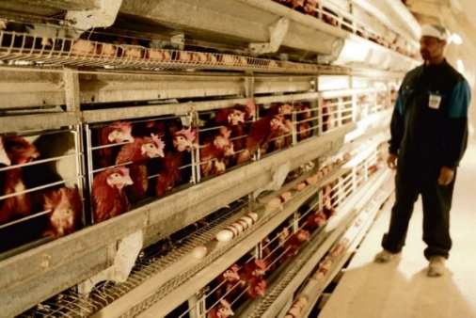
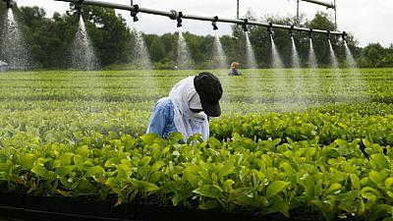
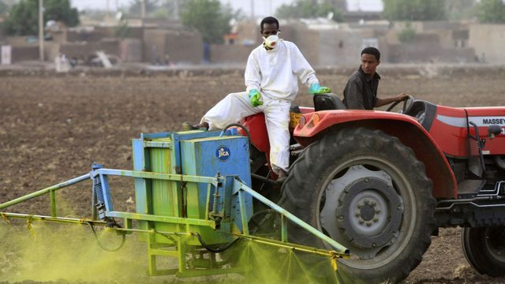
Context
821 million people around the world currently suffer from chronic malnutrition
9.7 billion humans will live on Earth in 2050
The current agro-industrial model has not solved the problem of hunger
global warming
soil depletion
ecosystem degradation

Slide 4
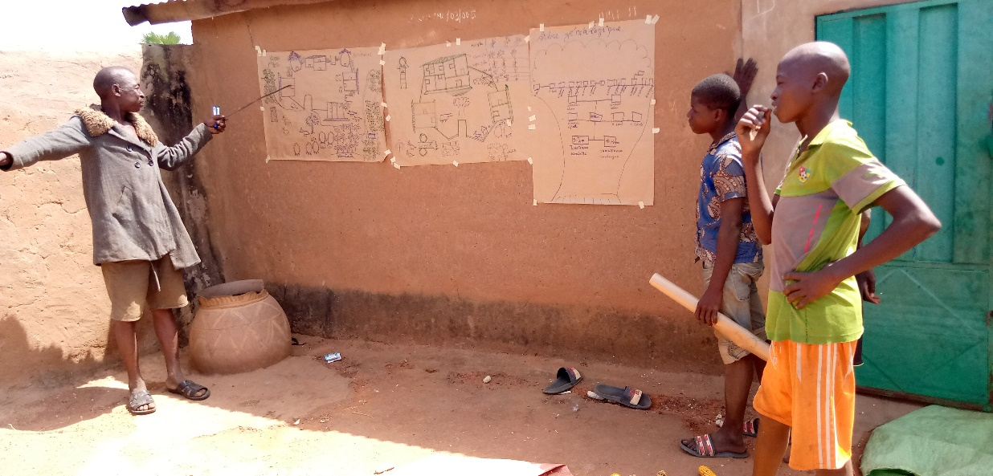
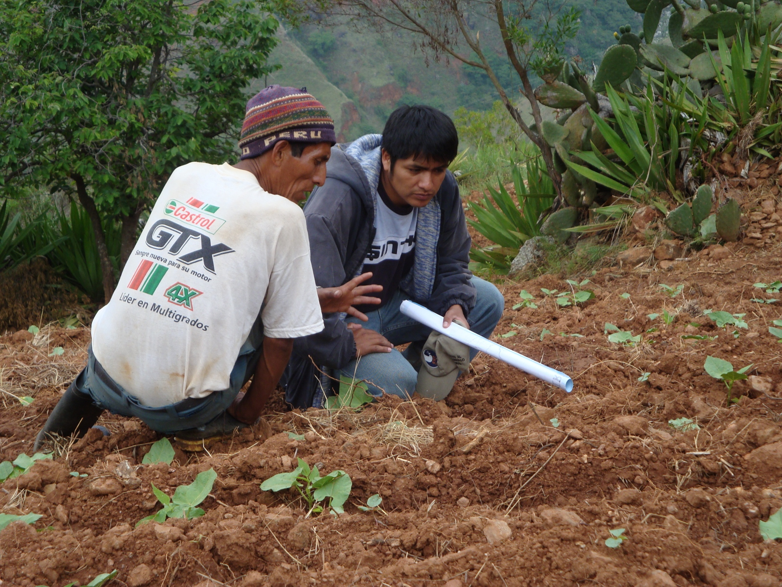
Our action
We focus our action on the promotion of sustainable family farming and responsible food with an emphasis on training.

Slide 5
Our 3 learning axes:
Producing more and better
Sustainable agro-ecological solutions
Autonomy of producers
Sustainable natural resources management.
Managing stocks and generating revenue
Delaying and or storing production in order to adapt to market demand and enhancing food supplies
Generating new incomes after raw material processing
Focus on self-consumption and local markets
Promoting an enabling environment
Raising awareness among consumers, the authorities and the Luxembourg population

Slide 6
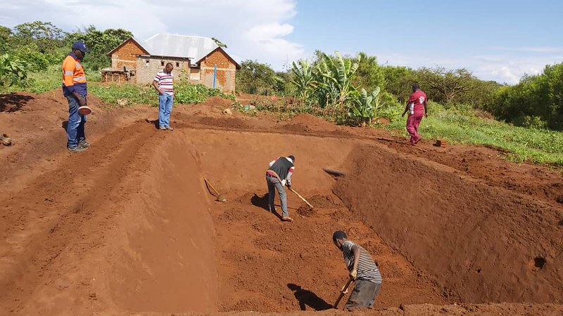
7 principles for effective and sustainable action
Self-help
Proximity
Simple, inexpensive techniques
Training at the heart of the project
Collaboration with local authorities
Temporary support
Encourage dissemination of good practice

Slide 7
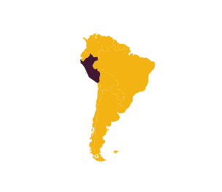
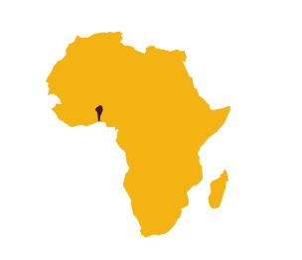
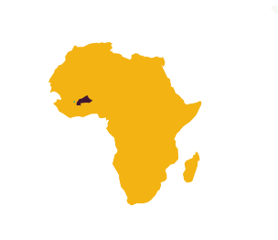
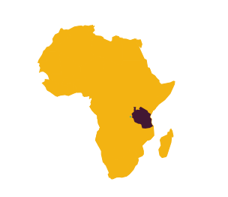
Current programmes
Benin
Uganda
Peru
Tanzania
Burkina Faso
Iles de Paix in numbers:
More than 50 years’ proven results
300 000 people helped directly and/or trained
every year
Projects in 5 countries
Funding through:
Equity financing (fundraisings, legacy and donations)
Public offices such as the Belgian ministry of Cooperation and Development, the Foreign affairs Ministry of Luxembourg (MAEE)

Slide 8
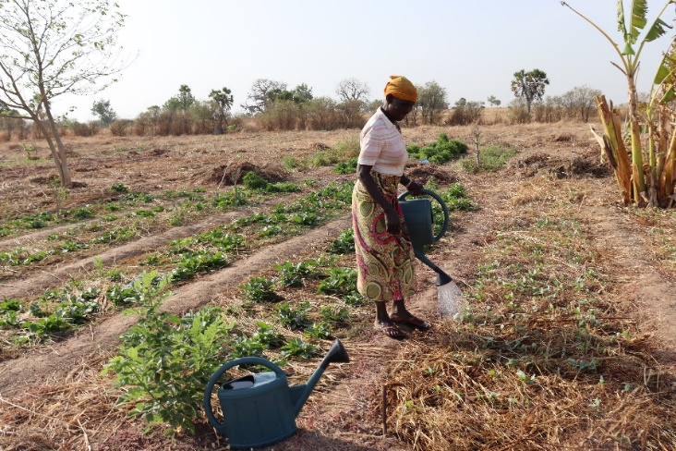
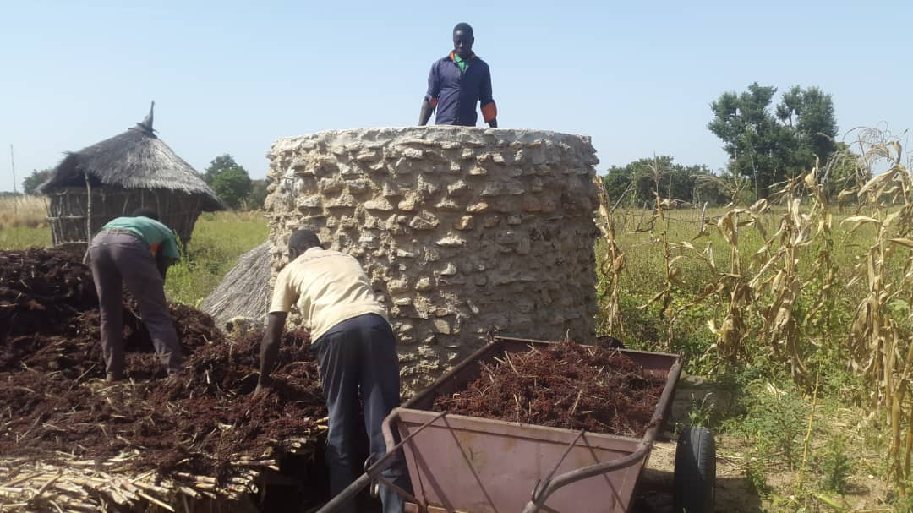
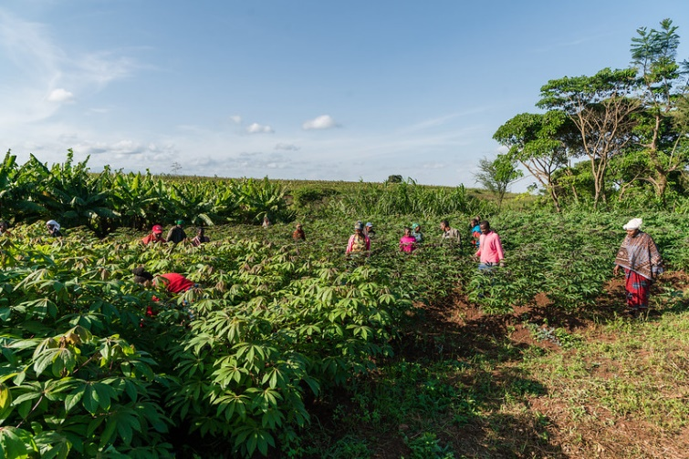
Key elements of the programmes
Peru: Municipality of Umari, Andes Mountains
Sanitation and agroecology
341 families
Benin: 3 Communes in the North
Agroécologie et post production
350 families, 3000 people
Tanzania: The Arusha region
Accès à l’eau et agroécologie
800 families, 4800 people
Uganda: In and around Fort Portal
Agroécology
750 families, 3375 people
Burkina Faso : 4 Municipalities in the east
Post production
750 families – 4200 people

Slide 9
Iles de Paix Luxembourg in a nutshell :
Board of Directors (a team of volunteers) & 2 employees focusing on Fund raising, Communication and Eduction for sustainable development
Training is the key word – our leitmotiv: « Give a Man a Fish, and You Feed Him for a Day. Teach a Man To Fish, and You Feed Him for a Lifetime”
Programs in Africa and Peru with often a major focus on women (“activités génératrices de revenus”)
Tailored reporting to partners
All donations go into the programs (no salary, admin. fees paid by donations)
Promotion of awareness on sustainability through our Education program in Luxembourg schools

Slide 10
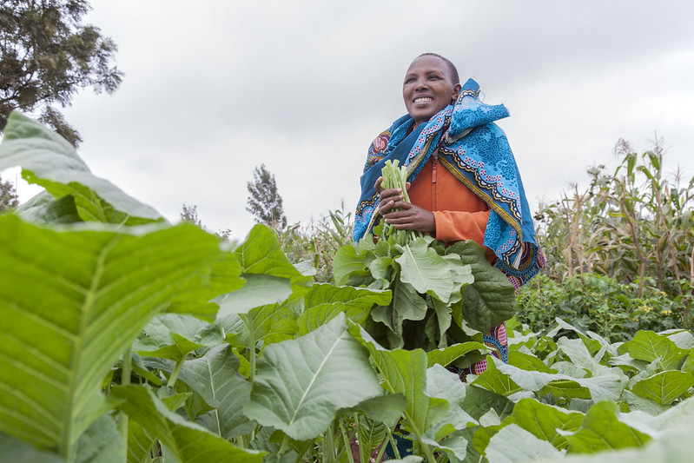
www.ilesdepaix.lu Florence Lagravere 202, route de Luxembourg L-7241 Bereldange +352 621 815 458
Thank You !

